Slide 1
Digital Marketing Capstone
Crafting Compelling Web Presences

Slide 2

APPLE

Slide 3
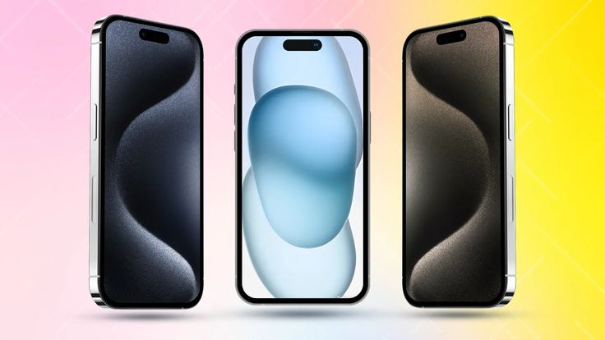
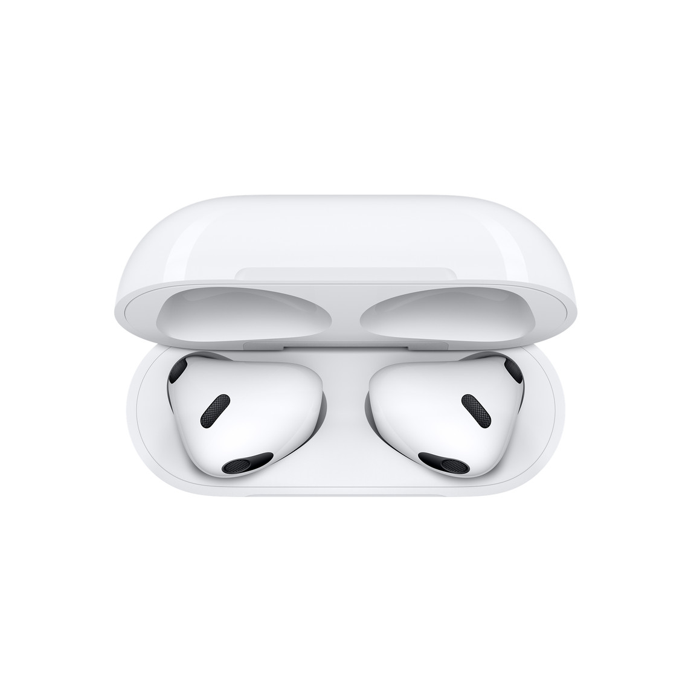
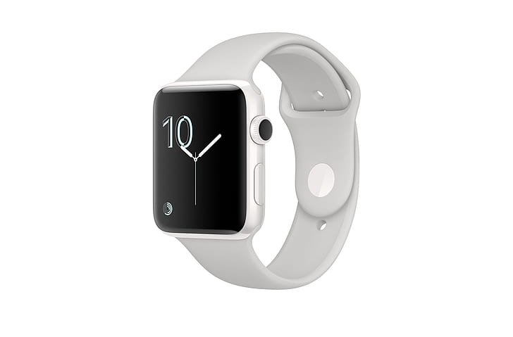


Products

Slide 4
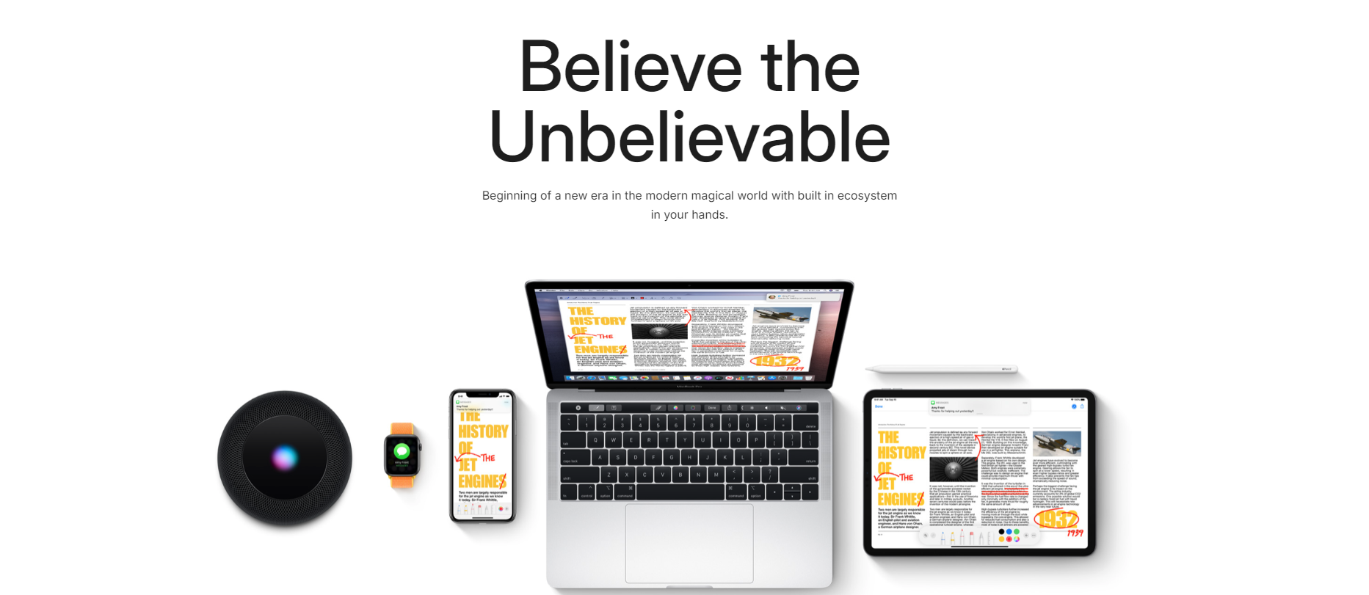
Main Page

Slide 5
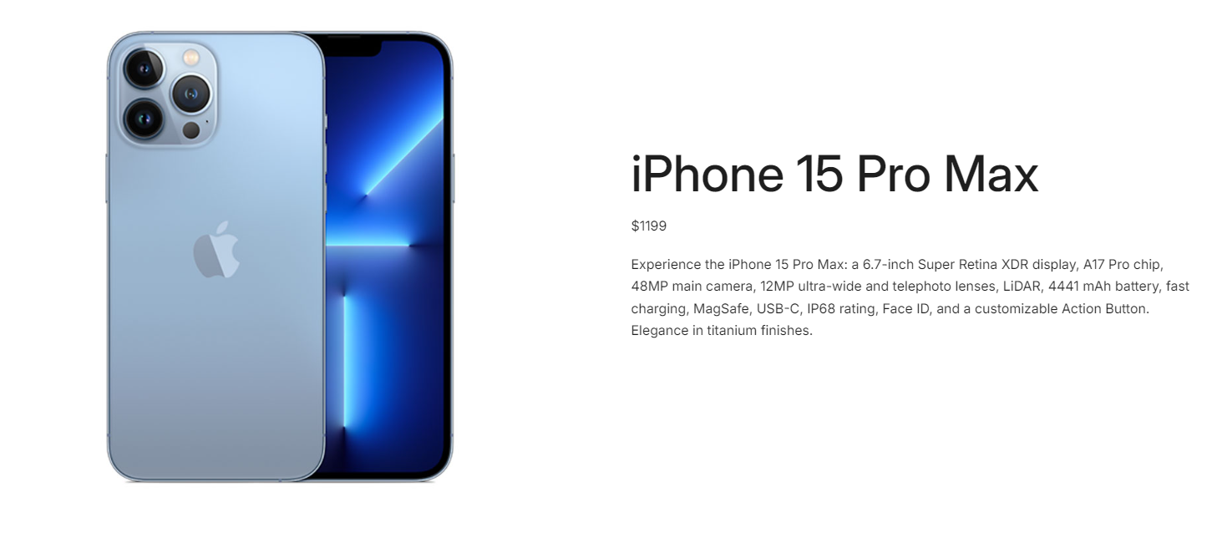
iPhone

Slide 6
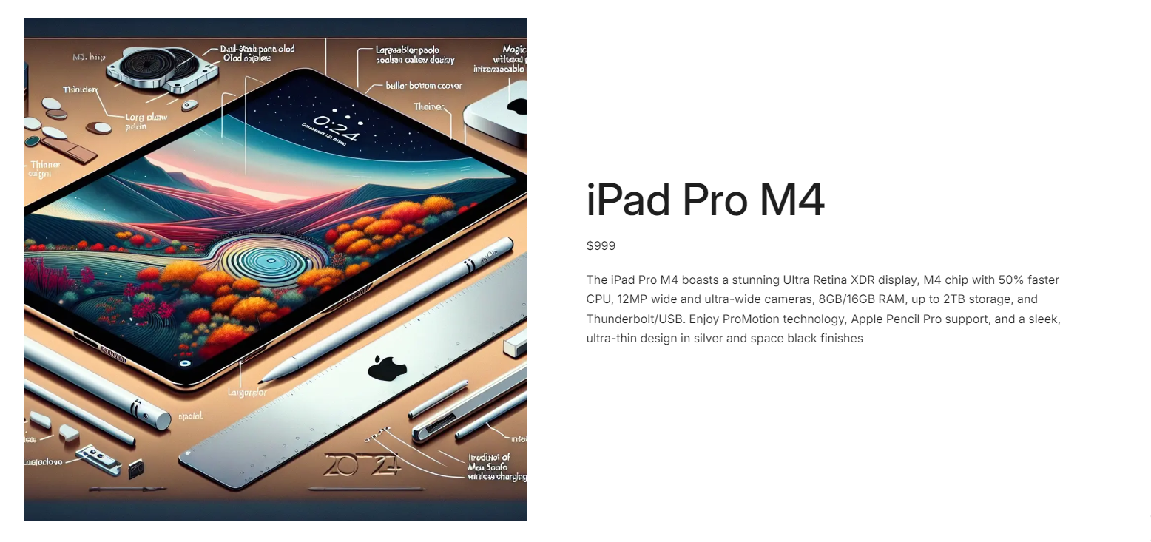
iPad

Slide 7
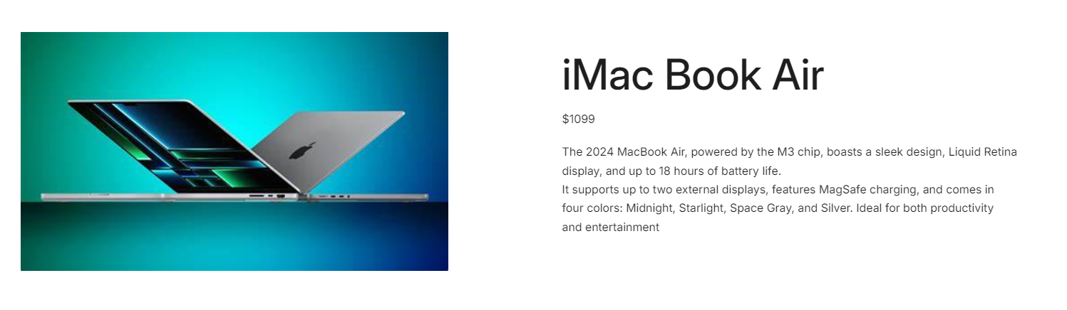
iMac

Slide 8
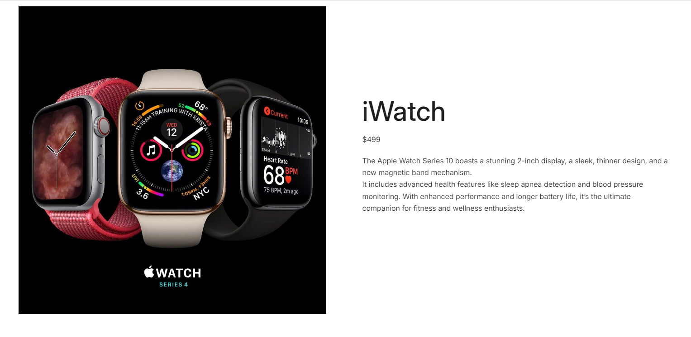
iWatch

Slide 9

Air pods

Slide 10

Determine the platform which the website is developed

Slide 11

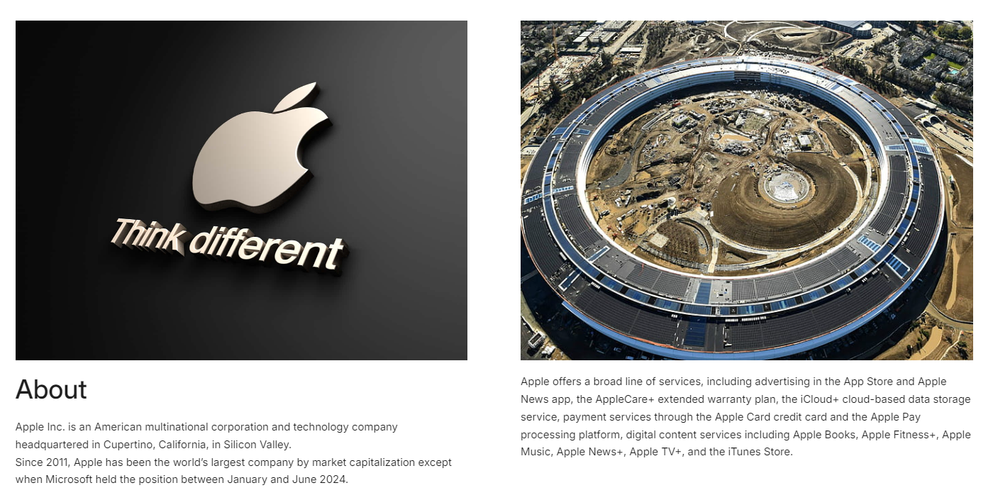
Website responsive Design
Laptop Phone

Slide 12
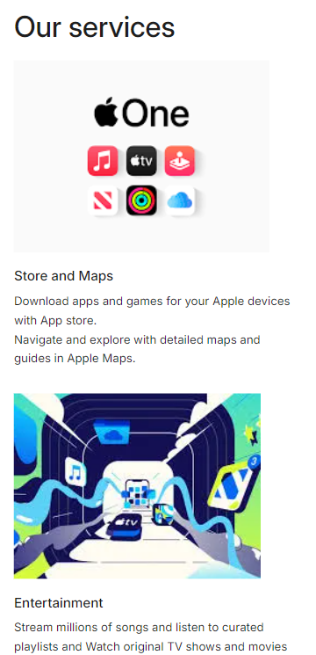
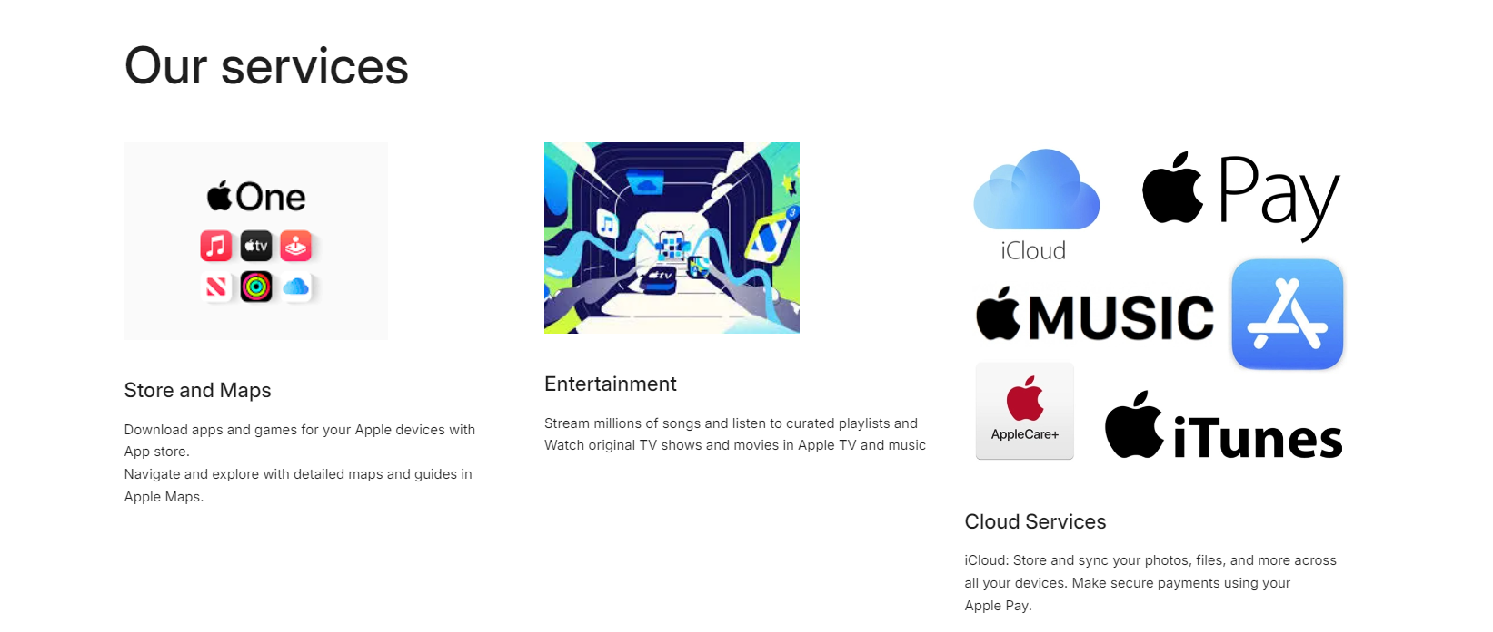
Website responsive Design
Laptop Phone

Slide 13
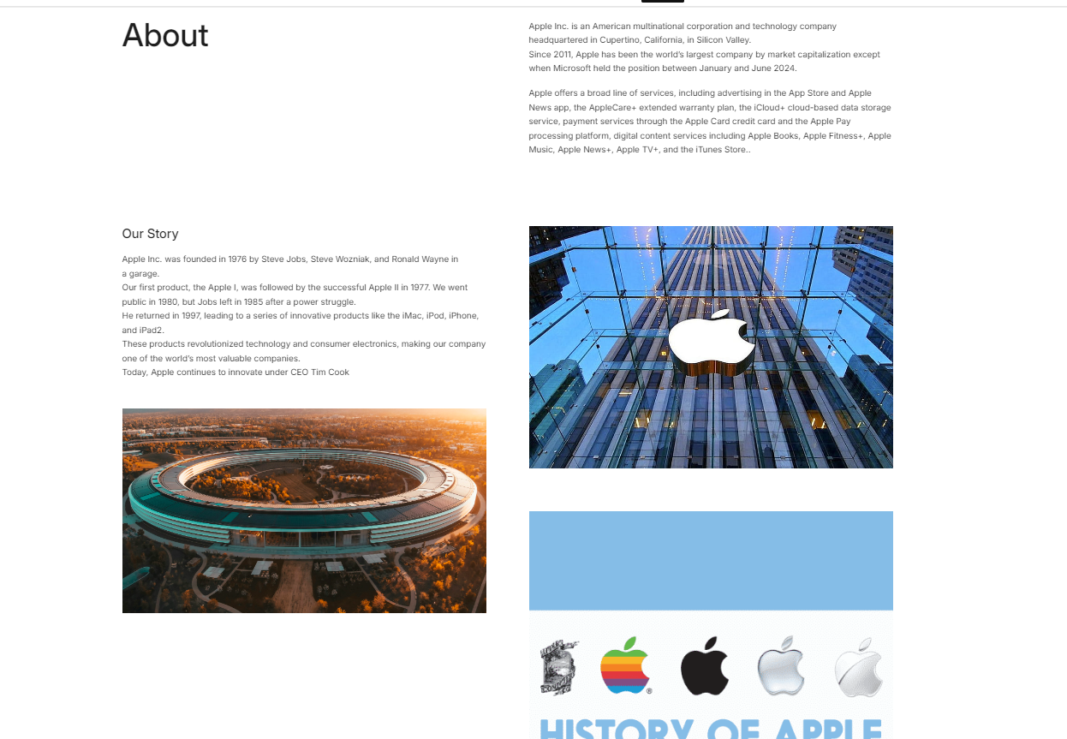
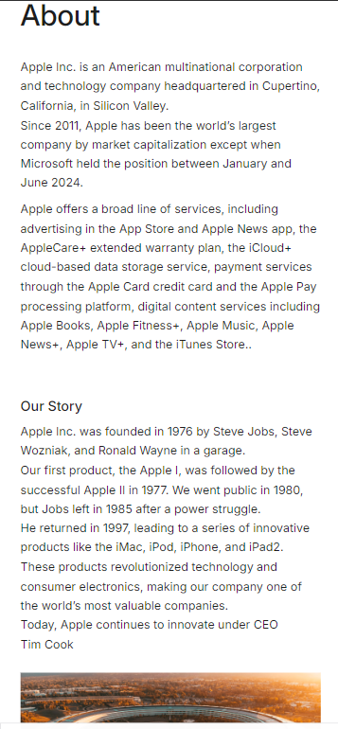
Website responsive Design
Laptop Phone

Slide 14
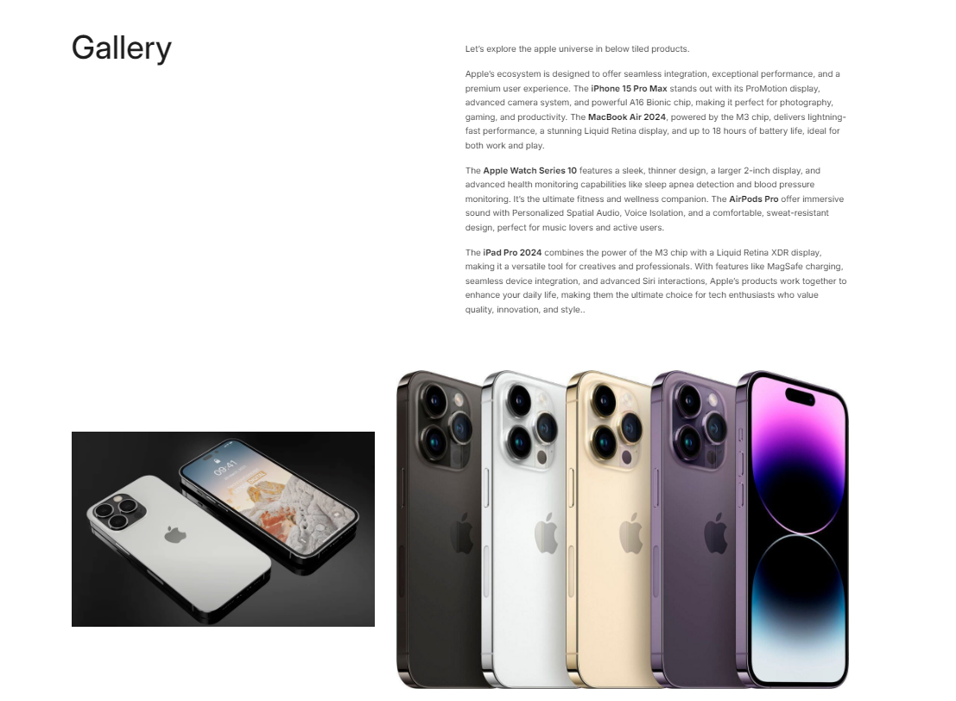
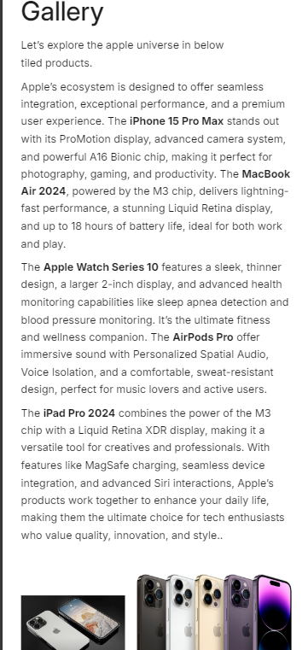
Website responsive Design
Laptop Phone

Slide 15
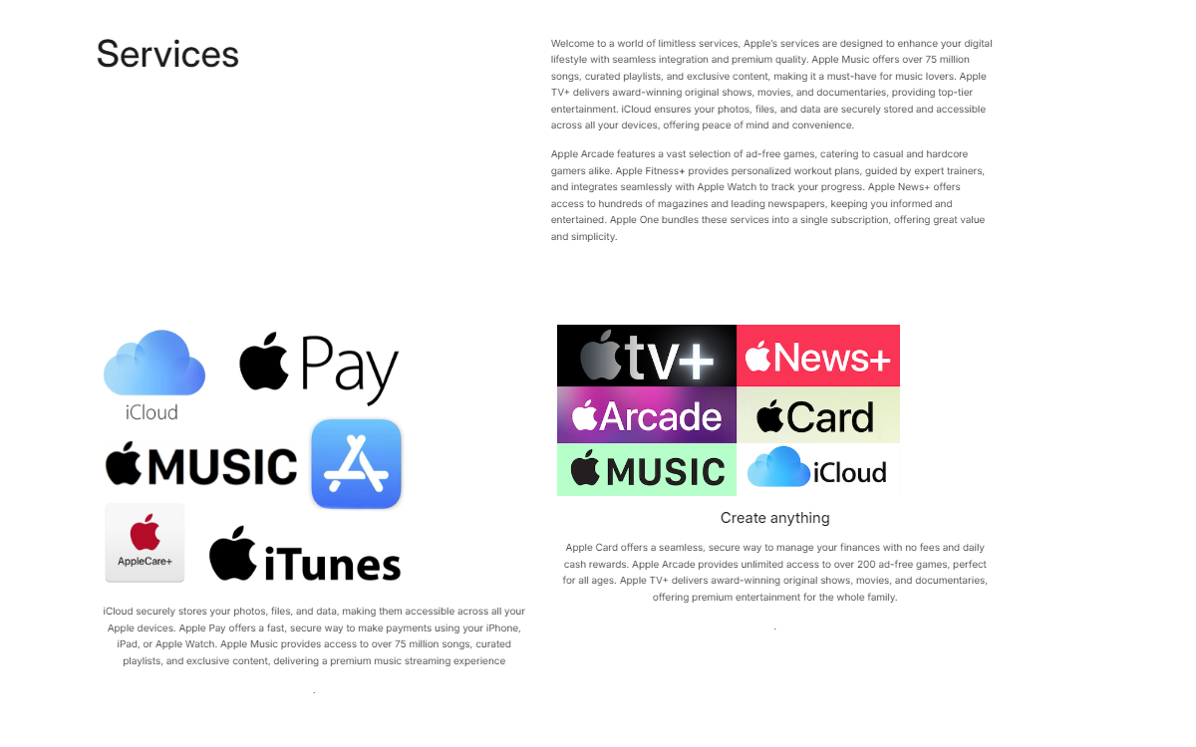

Website responsive Design
Laptop Phone

Slide 16
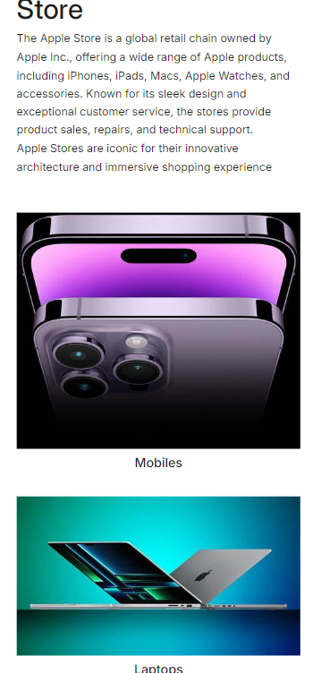
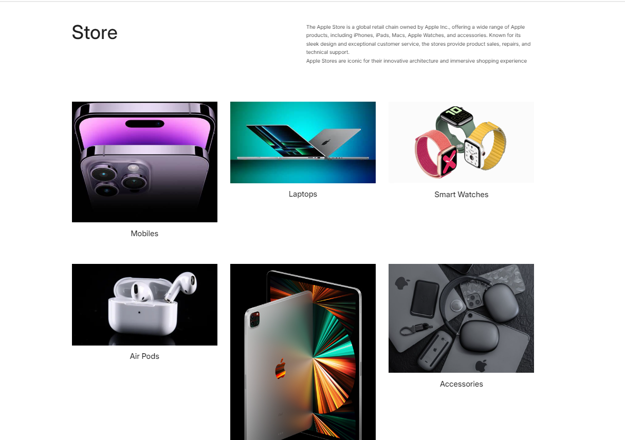
Website responsive Design
Laptop Phone

Slide 17
Identify the common website design mistakes to avoid
Lack of Mobile Optimization: With the increasing use of mobile devices, a site must be mobile-friendly. Ensure your design is responsive and functions well on various screen sizes.
Inconsistent Branding: Inconsistent use of colors, fonts, and styles can confuse visitors and weaken your brand identity. Maintain a cohesive look and feel throughout your site.
Poor Content Layout: A disorganized content layout can make it difficult for users to find the information they need. Use headings, bullet points, and short paragraphs to make content easily scannable.
Lack of Contact Information: Not providing clear contact information can frustrate users who need to reach out. Ensure your contact details are easily accessible on your site

Slide 18
Identify the common website design mistakes to avoid
Cluttered Layouts: Overloading a page with too many elements can overwhelm visitors. Ensure a clean, organized design with ample white space to improve readability and navigation.
Slow Loading Times: Visitors are likely to leave if a site takes too long to load. Optimize images, use a content delivery network (CDN), and minify code to enhance loading speeds.
Poor Navigation: Complicated or unclear navigation can frustrate users. Implement a simple, intuitive menu structure to help visitors find what they need quickly.

Slide 19
Identify the common website design mistakes to avoid
Simplicity: Keep your design clean and uncluttered. Avoid unnecessary elements that don’t serve a functional purpose.
Visual Hierarchy: Arrange and organize elements so that visitors naturally gravitate toward the most important parts first. Use size, color, and placement to guide users’ attention.
Responsive Design: Ensure your website looks and functions well on all devices, including desktops, tablets, and smartphones.
Consistent Branding: Use a consistent color scheme, typography, and style throughout your site to strengthen your brand identity.
Fast Loading Times: Optimize images, use a content delivery network (CDN), and minimize code to ensure your site loads quickly.

Slide 20
Identify the common website design mistakes to avoid
Easy Navigation: Implement a simple, intuitive menu structure to help visitors find what they need quickly. Use clear labels and logical organization.
High-Quality Images: Use high-resolution images that are relevant to your content. Avoid stock photos that look generic or overused.
Whitespace: Use whitespace effectively to make your content more readable and to highlight important elements
Accessible Design: Ensure your website is accessible to all users, including those with disabilities. Use alt text for images, provide keyboard navigation, and ensure sufficient color contrast.
User-Centric Design: Focus on the needs and preferences of your users. Conduct user testing and gather feedback to continuously improve the user experience

Slide 21
Landing Page Link
https://bharanibkm666.systeme.io/apple-landingpage

Slide 22
Thank You

